Slide 1
Modeling raw audio with ADAs
Sam Hinds
CS4347

Slide 2
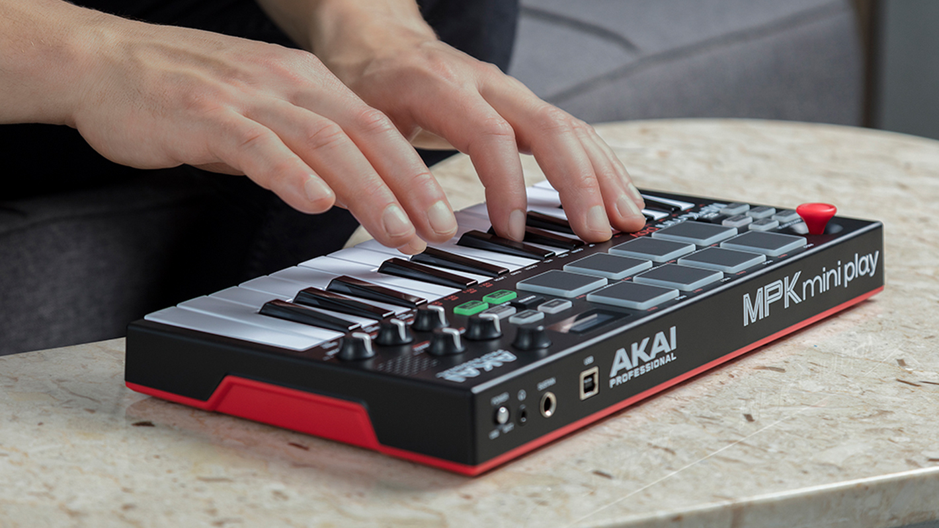
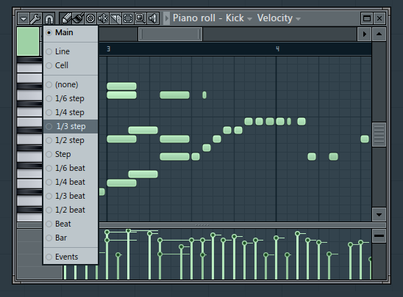
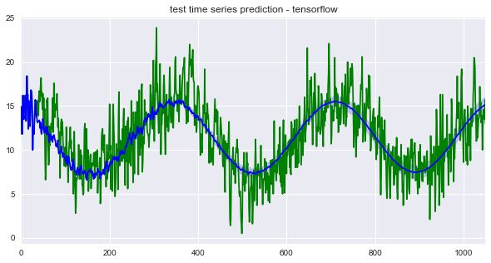
Background introduction
Problem: Typically in current methods of building generative models for music creation higher level representations such as MIDI data or music scores are used as data. Although this has held up fine, if our end goal is realistic music generation there are some keys issue..
MIDI data abstracts away many of the small nuances that are critical to realism in our brain’s perception of live music performance
Although vanilla autoregressive modeling can produce speech fair enough, bias towards capturing local areas of signal are not helpful as music requires modeling long range correlations.

Slide 3
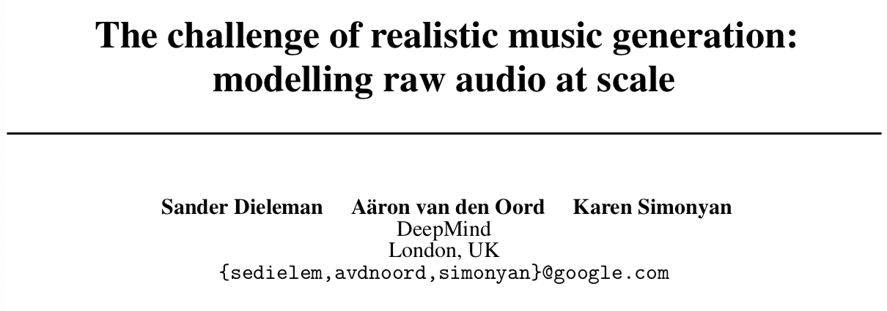
Literature Survey
NIPS 2018
”The nuances abstracted away by such representations are often musically quite important and greatly impact our enjoyment of music”

Slide 4
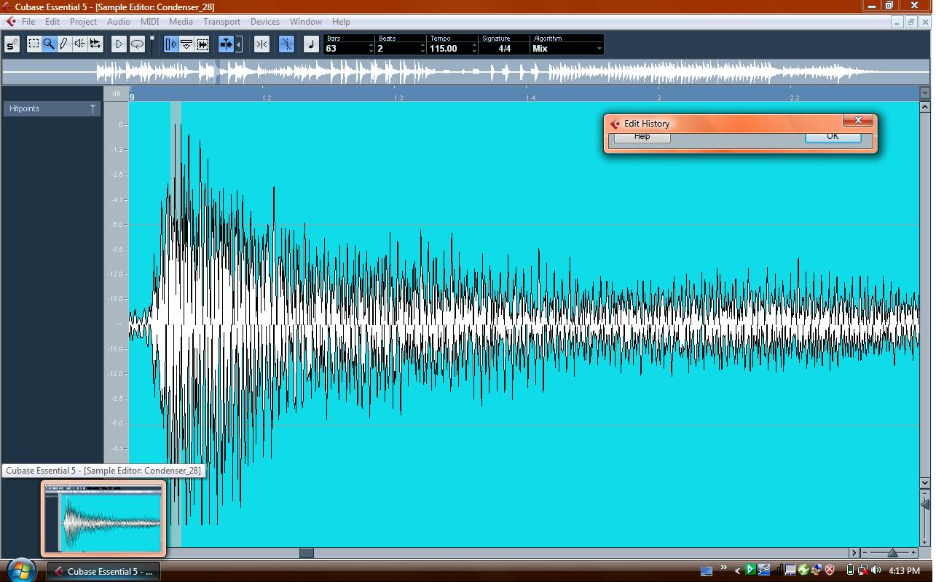
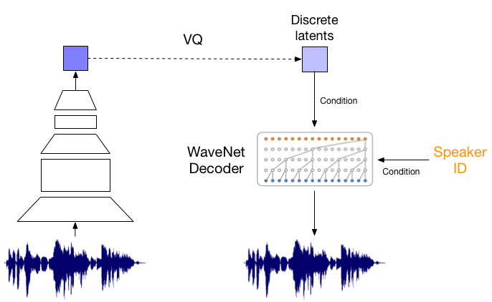
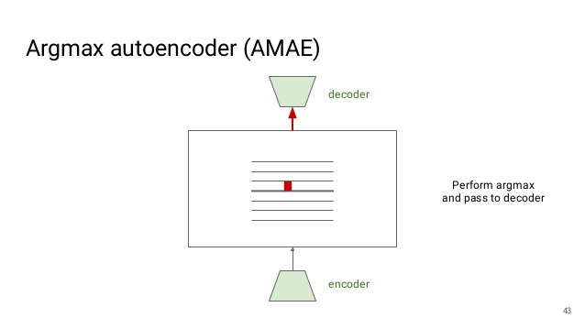
Addressing the problem
1. Exploration of music generation in raw audio domain: very hard
2. Investigating the current capabilities of base AR models and enlarge their receptive fields using (ADAs) Autoregressive discrete encoders
3. Introduction of (AMAE) argmax autoencoder for enhanced reliability on challenging datasets
“Turn an AR model into an autoencoder by attaching an encoder to learn a high-level conditioning signal directly from the data”

Slide 5

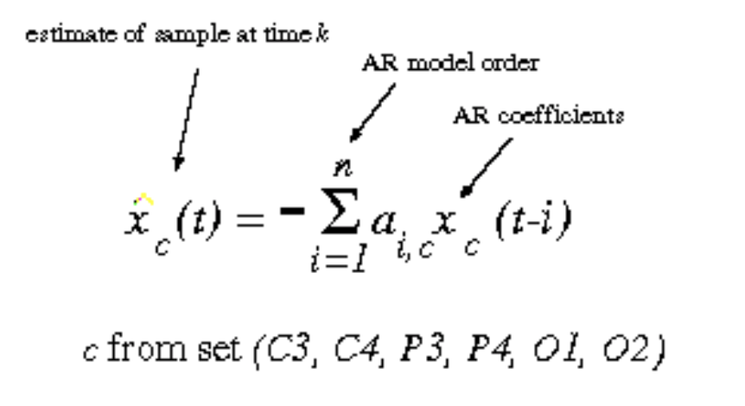
Autoregressive modeling
Learning from a series of timed steps and taking measurements from previous actions as inputs to a regression model in order to predict the value of the next time step

Slide 6
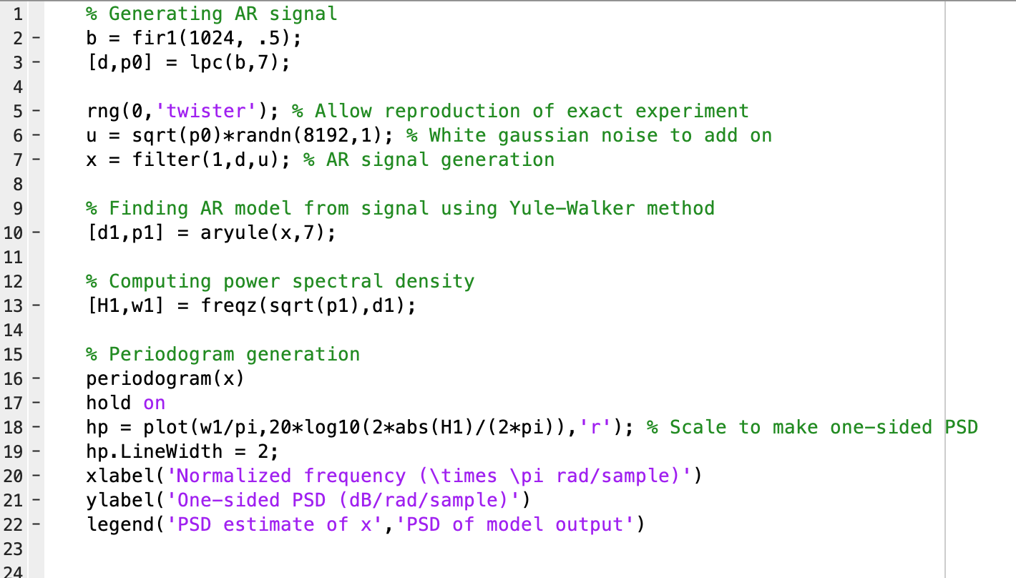
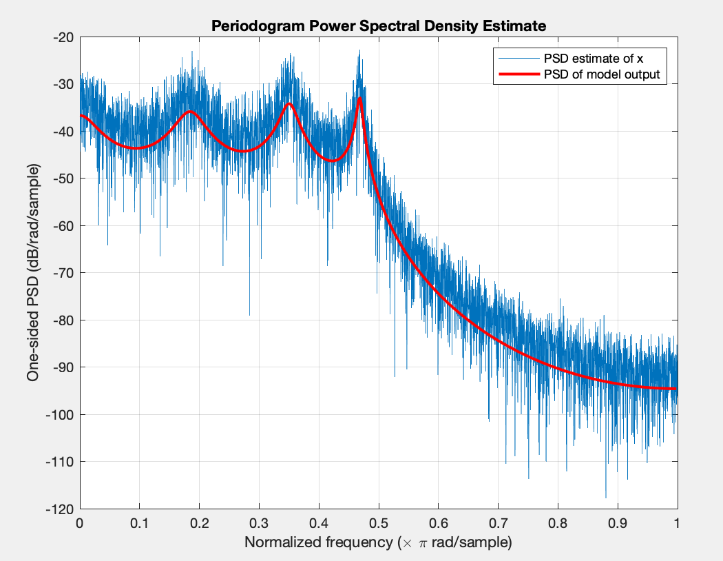
Experiment with AR signals in MATLAB

Slide 7
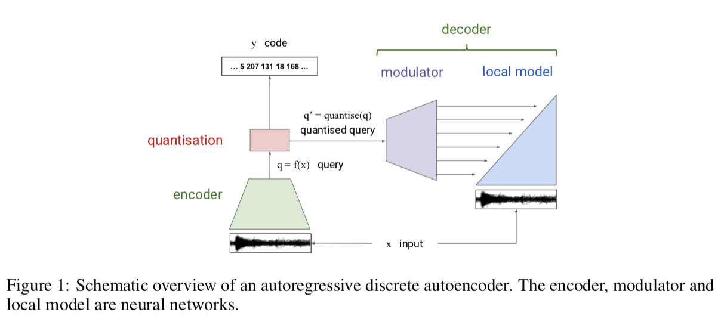
Enhancement via ADA
Primary approach to enlarging receptive fields by adding more convolutional layers can quickly run into issues as context and structure must be obtained from audio samples at least as long as their RFs. AKA: Hardware limits arise
A more computationally efficient method: Would be to implement Autoregressive discrete autoencoders
Encoder, modulator, and local model are neural nets
Encoder: computers high level representation of x
Decoder: Tries to reconstruct original waveform give high level representation
Quantization module: takes continuous encoder output and ”converts” to discrete values

Slide 8
Enhancement via AMAE
Our Quantization approach can be enhanced through what researchers called argmax autoencoder (AMAE). This is a more reliable alternative to vector quantization variational autoencoders.
Bottom line: gradients that pass through it are more accurate

Slide 9
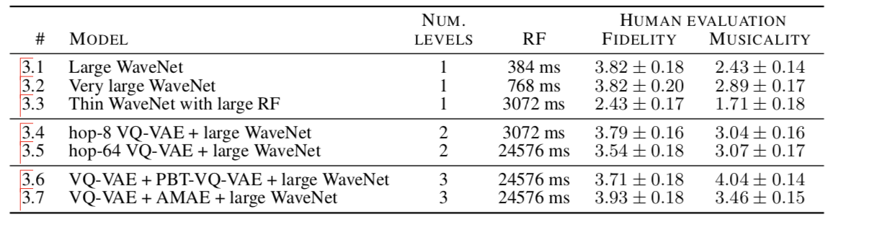

Experiment and results
Roughly 413 hours of recorded piano only WAV files.
Good polyphonic instrument
Single instrument reduces variation in timbres
To represent the waveforms as discrete sequences
Sampled at 16kHz and quantized to 8 bits
Larger bit depth = local bias
Receptive field of 64 timesteps yields best results
No argmax (AMAE)
With argmax (AMAE)

Slide 10
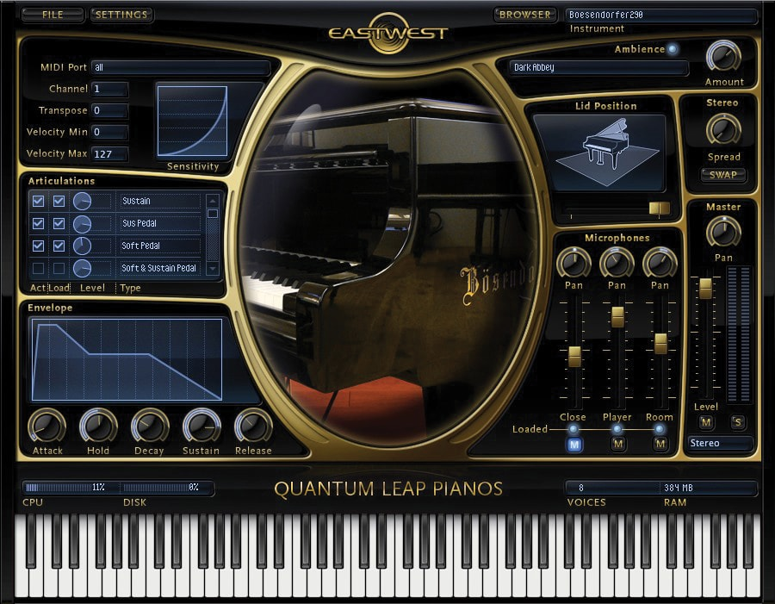
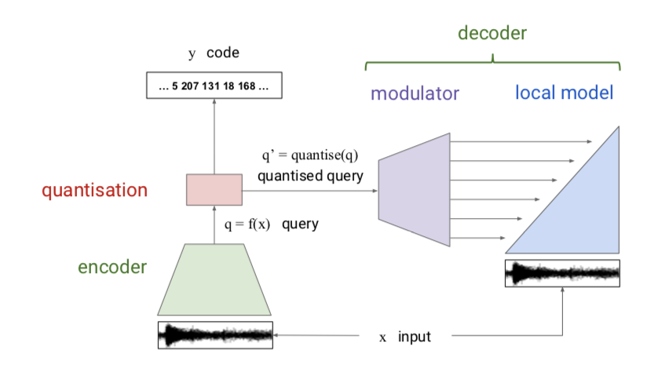



Conclusion / future work
- In conclusion it can be shown that autoregressive models are essentially a solid standard for audio waveform generation. The strength of modeling local signal variations is key as humans we perceive frequency changes in sound much easier than ”noise” in images
Using ADA to extend our possible receptive fields
AMAE to improve quantization stability
- A potential future improvement of the current model discussed could be to improve generated sample fidelity (via sample rate and bit depth) although this will require a lot more model capacity and training data. An interesting idea is to include high level conditioning info (Genre, composer, style, BPM, Key, etc.) to enhance musicality without having to deal with larger datasets
- Exciting future work with this model also could involve creation of a VST/AU audio plugin for use in a user’s DAW where they could select basic parameters and essentially generate and render real time instruments into their song without using MIDI or any prior musical input.

Slide 11
References
https://papers.nips.cc/paper/8023-the-challenge-of-realistic-music-generation-modelling-raw-audio-at-scale.pdf
https://en.wikipedia.org/wiki/Autoregressive_model
https://www.mathworks.com/help/signal/examples/linear-prediction-and-autoregressive-modeling.html

